Slide 1
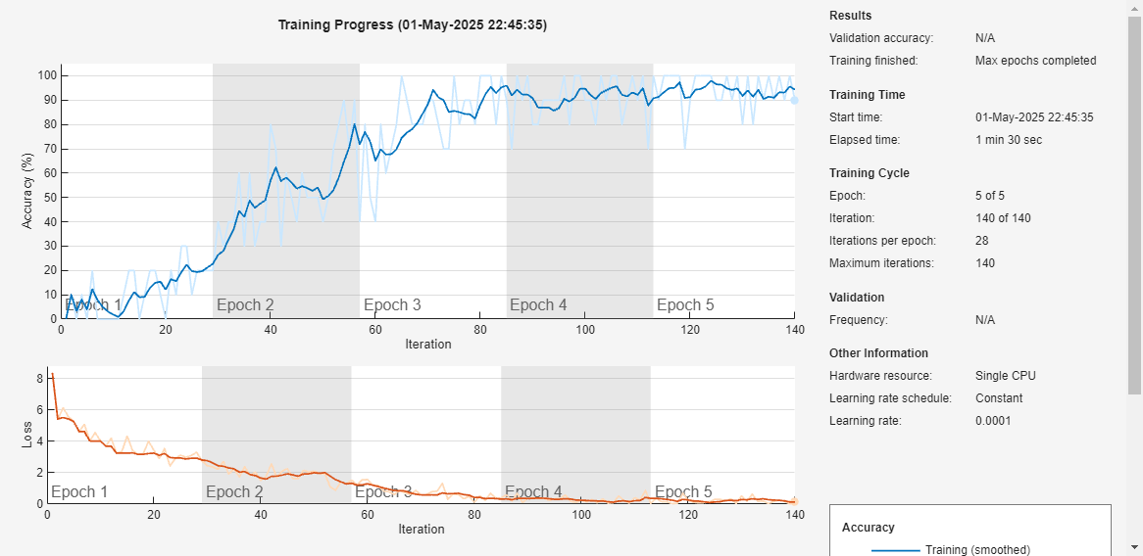
Training Alexa

Slide 2
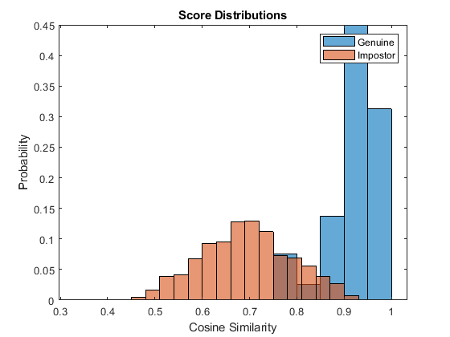
Histogram Alexa

Slide 3
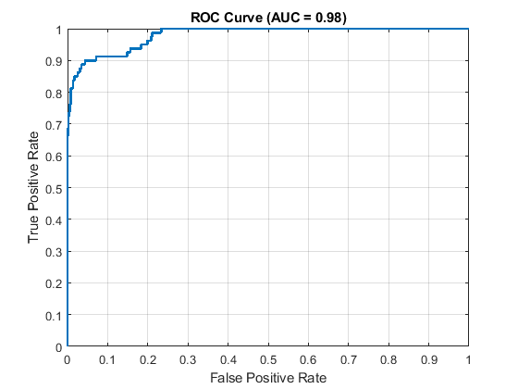
ROC Curve Alexa

Slide 4
My thoughts are that the Histogram doesn’t overlap too much so that’s good. The ROC curve could be closer to the corner but the AUC is close to one.

